Slide 1

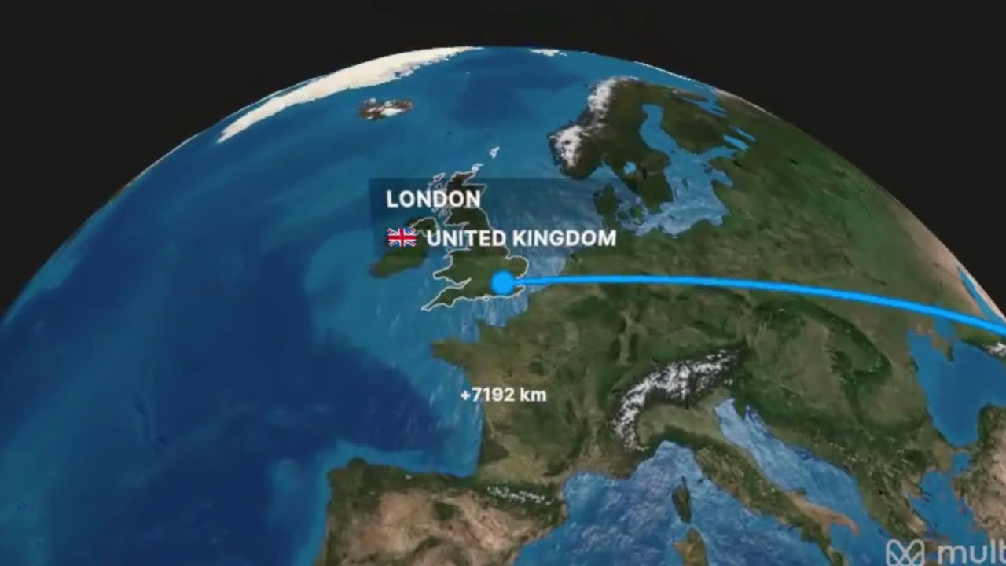

AISHWARYA CHOURASIA

